Slide 1
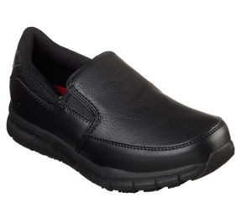
Product Data Sheet​
​
Product Code: 77157EC BLK
​Product Name: NAMPA - groton
Size Range: 3-8
Standard: EN ISO 20347:2012
Category: OB SRC FO
Construction/Features and Benefits​
Relaxed Fit® design for a roomier comfortable fit
Synthetic overlays at toe, sides and heel for added durability
Front toe overlay with stitched seam detail front
Mesh fabric collar panel for added breathable comfort
Dual side elastic fabric panels for easy slip on fit
Padded collar
Soft fabric shoe lining
Memory Foam full length cushioned removable comfort insole
Smooth synthetic upper
Slip Resistant flexible rubber traction outsole
Weight is 255g in a Women's Size 6

